Slide 1
Capstone Engagement
Assessment, Analysis, and Hardening of a Vulnerable System

Slide 2
Table of Contents
This document contains the following sections:
01
Network Topology
02
Red Team: Security Assessment
03
Blue Team: Log Analysis and Attack Characterization
Hardening: Proposed Alarms and Mitigation Strategies
04

Slide 3
Network Topology
3

Slide 4
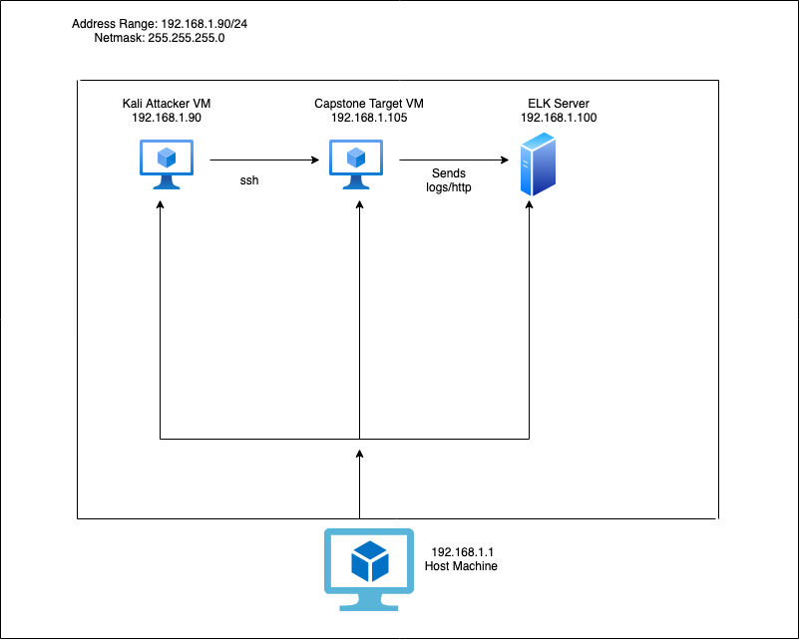
Network Topology
Network
Address Range: 192.168.1.90/24
Netmask: 225.255.255.0
Gateway: 192.168.1.1
Machines
IPv4: 192.168.1.90
OS: Linux
Hostname: Kali
IPv4: 192.168.1.105
OS: Linux
Hostname: Capstone
IPv4: 192.168.1.100
OS: Linux
Hostname: ELK Server
IPv4: 192.168.1.1
OS: Windows
Hostname: Host Machine

Slide 5

Red Team
Security Assessment
5

Slide 6
Recon: Describing the Target
Nmap identified the following hosts on the network:
Hostname | IP Address | Role on Network
Kali | 192.168.1.90 | Attacker Machine
Capstone | 192.168.1.105 | Victim Machine
ELK Server | 192.168.1.100 | Collects data (the logs) to process
Hyper-V Azure | 192.168.1.1 | Host Machine

Slide 7
Vulnerability Assessment
The assessment uncovered the following critical vulnerabilities in the target:
Vulnerability | Description | Impact
Open port 80 | Open to access for anyone to who tries to enter. | An open port allows anyone to exchange information and access sensitive data/files
Local File Inclusion Vulnerability | LFI allows access into confidential files on a site. | An LFI vulnerability allows attackers to gain access to sensitive credentials
Brute Force Vulnerability | Attempting to login with multiple username and password combinations to get a correct combo. | Attacker can use tools like rockyou.txt files and John the ripper to crack the correct password.
Hashed Password | Hashing transforms a password into another string that, but if not salted can be cracked using online tools. | Ryan’s password was hashed but not salted so it was easy to attack.

Slide 8
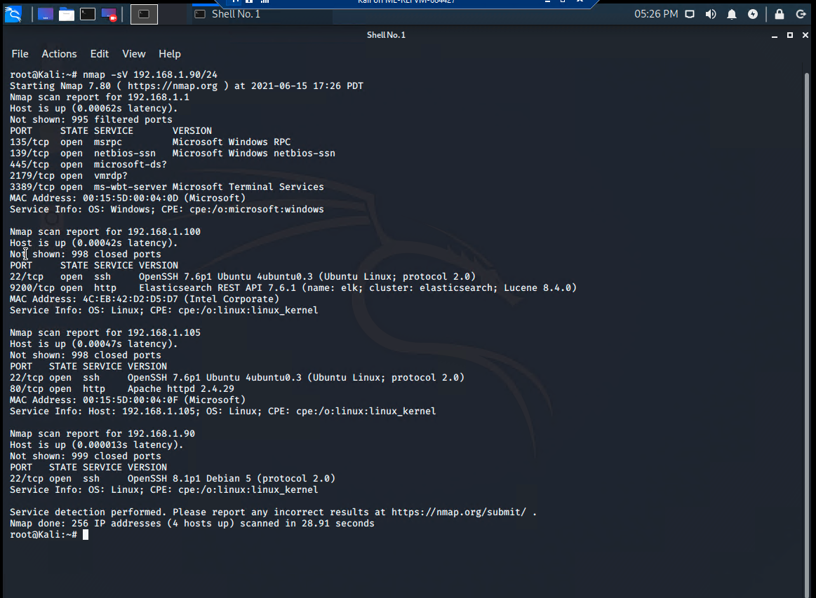
Exploitation: Open port 80
01
02
03
Tools & Processes
How did you exploit the vulnerability? We used the nmap tool.
Nmap -sV 192.168.1.90/24
Achievements
What did the exploit achieve? The nmap allowed us to see that port 80 was open with the IP address 192.168.1.105 so that we could exchange communication.

Slide 9
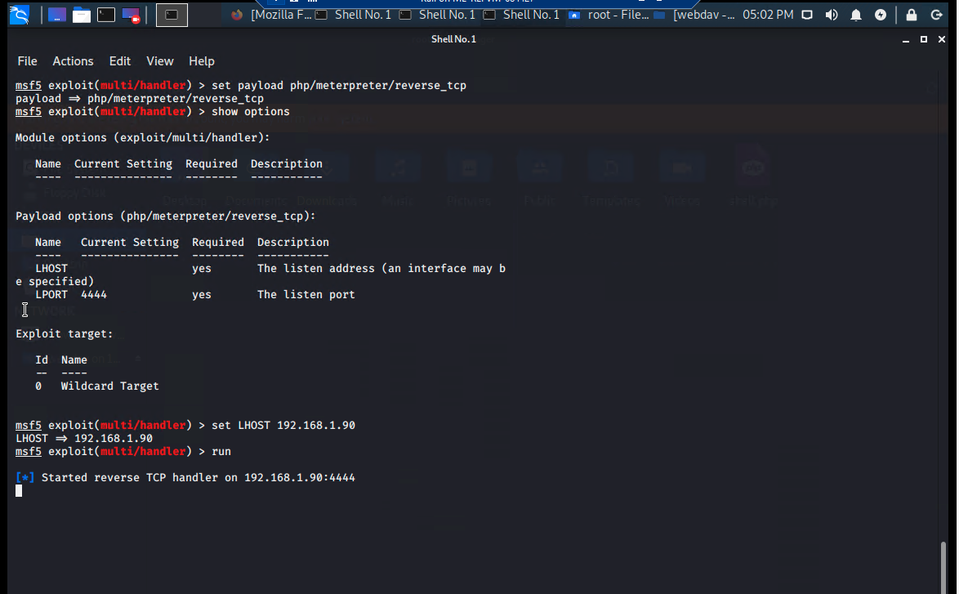
Exploitation: Local File Inclusion Vulnerability
01
02
03
Tools & Processes
How did you exploit the vulnerability? We used msfvenom and meterpreter to send a payload.
Achievements
What did the exploit achieve? Sending the payload allowed us access to the shell of the target machine.

Slide 10
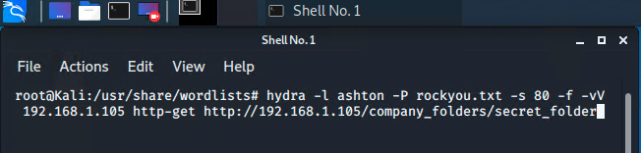
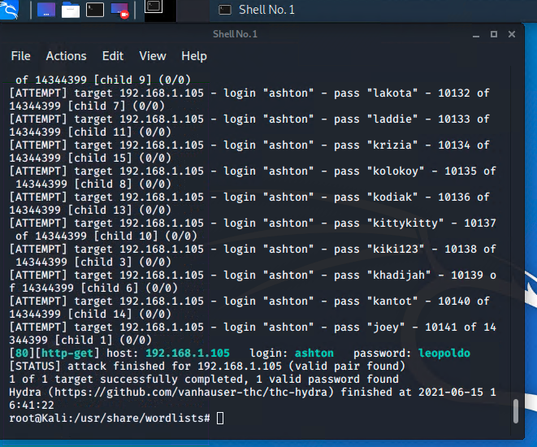
Exploitation: Brute Force Vulnerability
01
02
03
Tools & Processes
How did you exploit the vulnerability? We used the Hydra command to exploit this vulnerability.
Achievements
What did the exploit achieve?
We were able to access Ashton’s password using the wordlist rockyou.txt file.
Notes:
COMMAND: hydra -l ashton -P rockyou.txt -s 80 -f -vV 192.168.1.105 http-get http://192.168.1.105/company_folders/secret_folder

Slide 11

Blue Team
Log Analysis and Attack Characterization
11

Slide 12

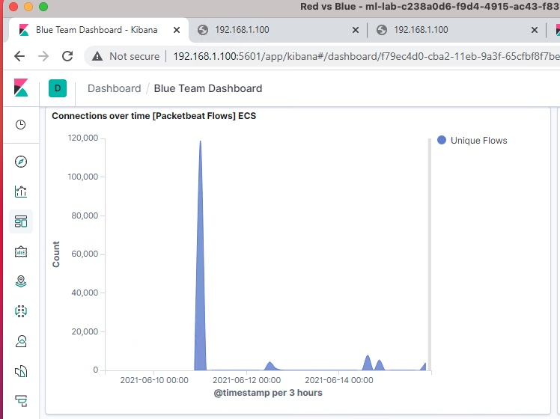
Analysis: Identifying the Port Scan
Answer the following questions in bullet points under the screenshot if space allows. Otherwise, add the answers to speaker notes.
What time did the port scan occur?
How many packets were sent, and from which IP?
What indicates that this was a port scan?
Notes:
The interaction occurred on June 11th at 11:00pm
There were 82,232 packets sent made to this directory from the 192.168.1.90
There was a sudden spike in the network traffic

Slide 13
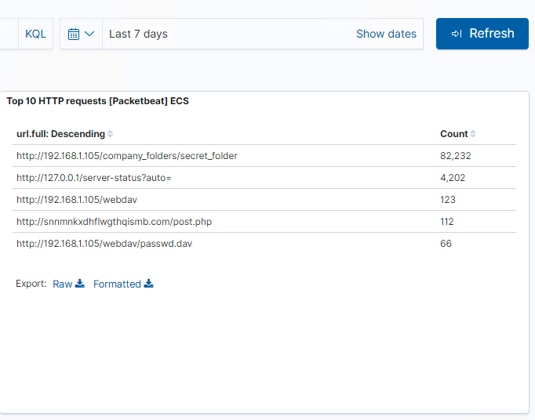
Analysis: Finding the Request for the Hidden Directory
Answer the following questions in bullet points under the screenshot if space allows. Otherwise, add the answers to speaker notes.
What time did the request occur? How many requests were made?
Which files were requested? What did they contain?
Notes:
- there were 82,232 requests made to this directory from the 192.168.1.90 on June 11th at 11:00pm
- the file requested was /company_folders/secret_folder/connect_to_corp_server. The file connect_to_corp_server contains a hashed password and instructions on how to connect to company server.

Slide 14
Analysis: Uncovering the Brute Force Attack
Answer the following questions in bullet points under the screenshot if space allows. Otherwise, add the answers to speaker notes.
How many requests were made in the attack?
How many requests had been made before the attacker discovered the password?
Notes:
there were 66 requests
the attacker was able to discover the correct password on the first attempt.

Slide 15
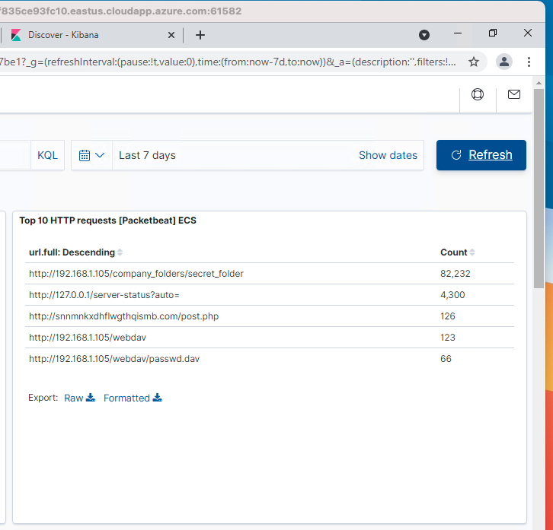
Analysis: Finding the WebDAV Connection
Answer the following questions in bullet points under the screenshot if space allows. Otherwise, add the answers to speaker notes.
How many requests were made to this directory?
Which files were requested?
Notes:
There were 123 requests made
There were 66 requests for file /webdav/passwd.dav

Slide 16
Blue Team
Proposed Alarms and Mitigation Strategies
16

Slide 17
Mitigation: Blocking the Port Scan
What kind of alarm can be set to detect future port scans?
- Alert to go off upon number port scans requests per seconds.
What threshold would you set to activate this alarm?
- Alarm should activate if there 10 port scans request/seconds for more than five seconds from any given IP address
What configurations can be set on the host to mitigate port scans?
Close unused ports
Have an IP whitelist
Describe the solution. If possible, provide required command lines.
Regularly run a port scan to detect /alert any open ports.
nmap –sV ip address/net range

Slide 18
Mitigation: Finding the Request for the Hidden Directory
What kind of alarm can be set to detect future unauthorized access?
- I would create an alert that would go off every time someone tried to access the secret_folder directory from a non-whitelisted IP.
What threshold would you set to activate this alarm?
- Unauthorized IP trying to access should trigger the alarm
What configuration can be set on the host to block unwanted access?
I would remove the directory from being hosted online.
Encrypt the data if it must stay online
Locally restrict data from user access (principle of least privilege)
Describe the solution. If possible, provide required command lines.
- NA

Slide 19
Mitigation: Preventing Brute Force Attacks
What kind of alarm can be set to detect future brute force attacks?
- I would set an alert for any login attempts after 5 times.
What threshold would you set to activate this alarm?
- Alarm should activate if there 100 login attempts/seconds for more than five seconds from any IP address
What configuration can be set on the host to block brute force attacks?
I would limit the number of login attempts. I would also limit the number of 401 responses and lock out the user from attempting another login.
Ban malicious looking IP addresses
Describe the solution. If possible, provide the required command line(s).
- NA

Slide 20
Mitigation: Detecting the WebDAV Connection
What kind of alarm can be set to detect future access to this directory?
- I would set an alert for whenever anyone from an external IP tries to access the /webdav/ directory.
What threshold would you set to activate this alarm?
- The alarm should trigger anytime an external IP tries to access unless on our IP whitelist
What configuration can be set on the host to control access?
- Administrators must install filebeat and configure it for monitoring the /webdav/ directory.
Describe the solution. If possible, provide the required command line(s).
- NA

Slide 21
Mitigation: Identifying Reverse Shell Uploads
What kind of alarm can be set to detect future file uploads?
- Uploading of a disallowed type of file such as .php file.
What threshold would you set to activate this alarm?
- Alarm should trigger upon the uploading of a forbidden file.
What configuration can be set on the host to block file uploads?
I would restrict right permission on the host machine.
Isolate uploads to a particular storage partition of the computer.
Have filebeat enabled and configured
Describe the solution. If possible, provide the required command line.
- NA

